Slide 1

February Bug
Jam
By Team “Test Titans”

Slide 2

Meet The Test Titans Team
Ayesha Habib - QA Alumni
Rosa Miranda - QA Student
Eduardo Villagomez - QA Student
We are Team Test Titans, and today we’re excited to present our Bug Jam results. During this challenge, we applied QA best practices, strong teamwork, and critical thinking to identify defects, analyze issues, and improve overall product quality. In this presentation, we’ll walk you through our testing approach, key bugs discovered, and the insights we gained throughout the process.

Slide 3
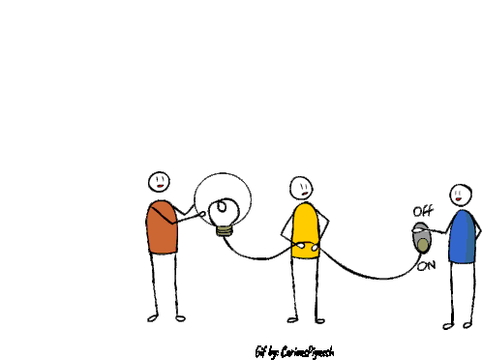

Team Communication
Maintained clear and consistent communication throughout the Bug Jam through tripleten Hub
Coordinated bug reporting to avoid duplication
Discussed priority and severity of bugs before final submissions

Slide 4

Notes:
“Time is one of the most valuable resources we have. Unlike money or opportunities, once time is gone, we can never get it back. In today’s fast-paced world, managing time effectively is essential for productivity and success.

Slide 5
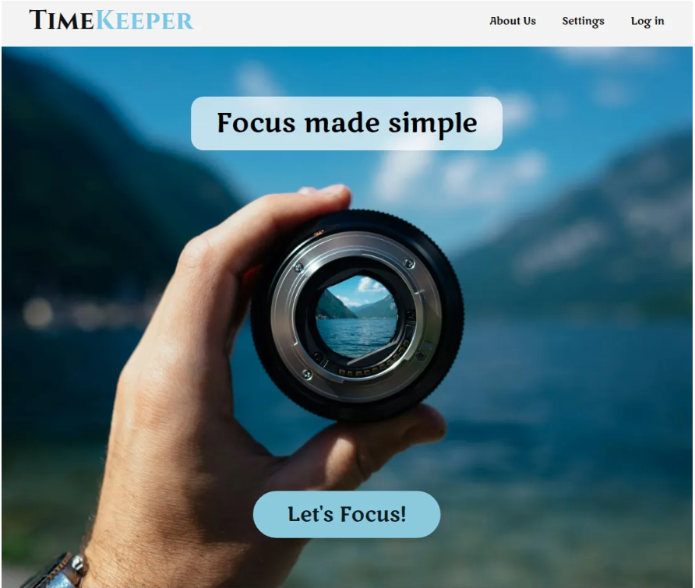
TimeKeeper App Introduction
📌 What is Timekeeper?
Timekeeper is a productivity web application designed to help
users manage focus sessions using customizable timers.
🎯 Purpose of the Application
Improve productivity
Help users stay focused
Allow users to select different timer durations
Provide an easy and distraction-free interface

Slide 6

Testing Performed – Manual & Automation
✅ Functional Testing
Verified navigation from Home page → Timer Selection page via “Let’s Focus” button
Verified display of three timer options (15, 25, 45 minutes)
Verified one timer is active and centered by default
Verified inactive timers reposition correctly (smaller left, larger right)
Verified selecting an inactive timer makes it active and moves it to center
Verified Start button navigates to Timer page and starts selected timer
Verified Pause, Resume, and Reset functionalities work correctly
Verified app logo returns user to Home page
Verified Great Job screen appears after timer completion
Verified weekly session count and minutes calculation
Verified New Session button returns to Timer Selection page

Slide 7

⚙️ Non-Functional Testing (Manual)
Visual layout verification (center alignment & positioning)
Responsiveness of timer selection
Performance observation during page load
Text Resize to 200% Causes Overlap
Mobile Layout Cut Off / Not Responsive
Missing Alternative Text for Non-Text Content on Home Page, About Us page, and Great Job screen.
Unclear and Inaccessible Language Across Pages
Layout Does Not Fully Adapt to Mobile Devices

Slide 8
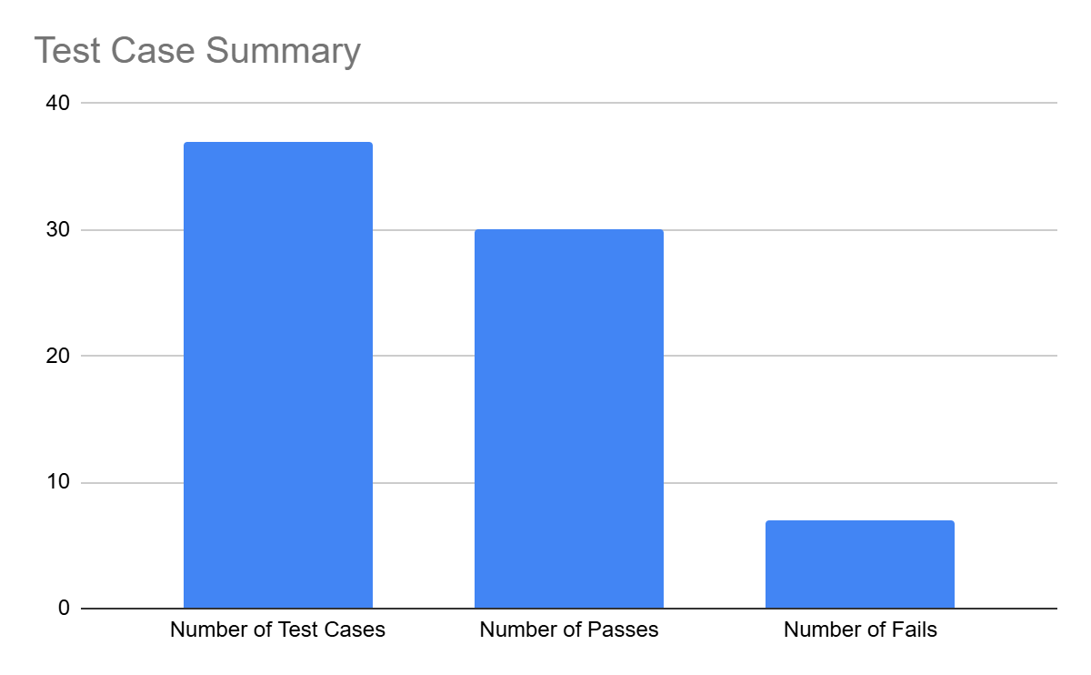
37
30
7

Slide 9

Made Detailed Bug Reports on JIRA
ID | Issue | Type | Severity | Impact
1 | Navigation buttons not clickable | Functional | Critical | Core navigation blocked
2 | Missing alternative text | Non-Functional (Accessibility) | Low | Screen reader users impacted
3 | Layout breaks at 200% zoom | Non-Functional (Accessibility) | Medium | Overlapping content
4 | Layout overlaps at 400×600 resolution | Non-Functional (Responsive) | Medium | Poor small-screen usability
5 | Mobile layout cut off on devices | Non-Functional (Responsive) | High | Incomplete mobile experience
6 | Unclear language & missing instructions | Non-Functional (Usability) | Medium | User confusion

Slide 10
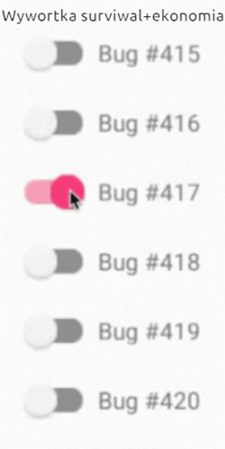

Slide 11
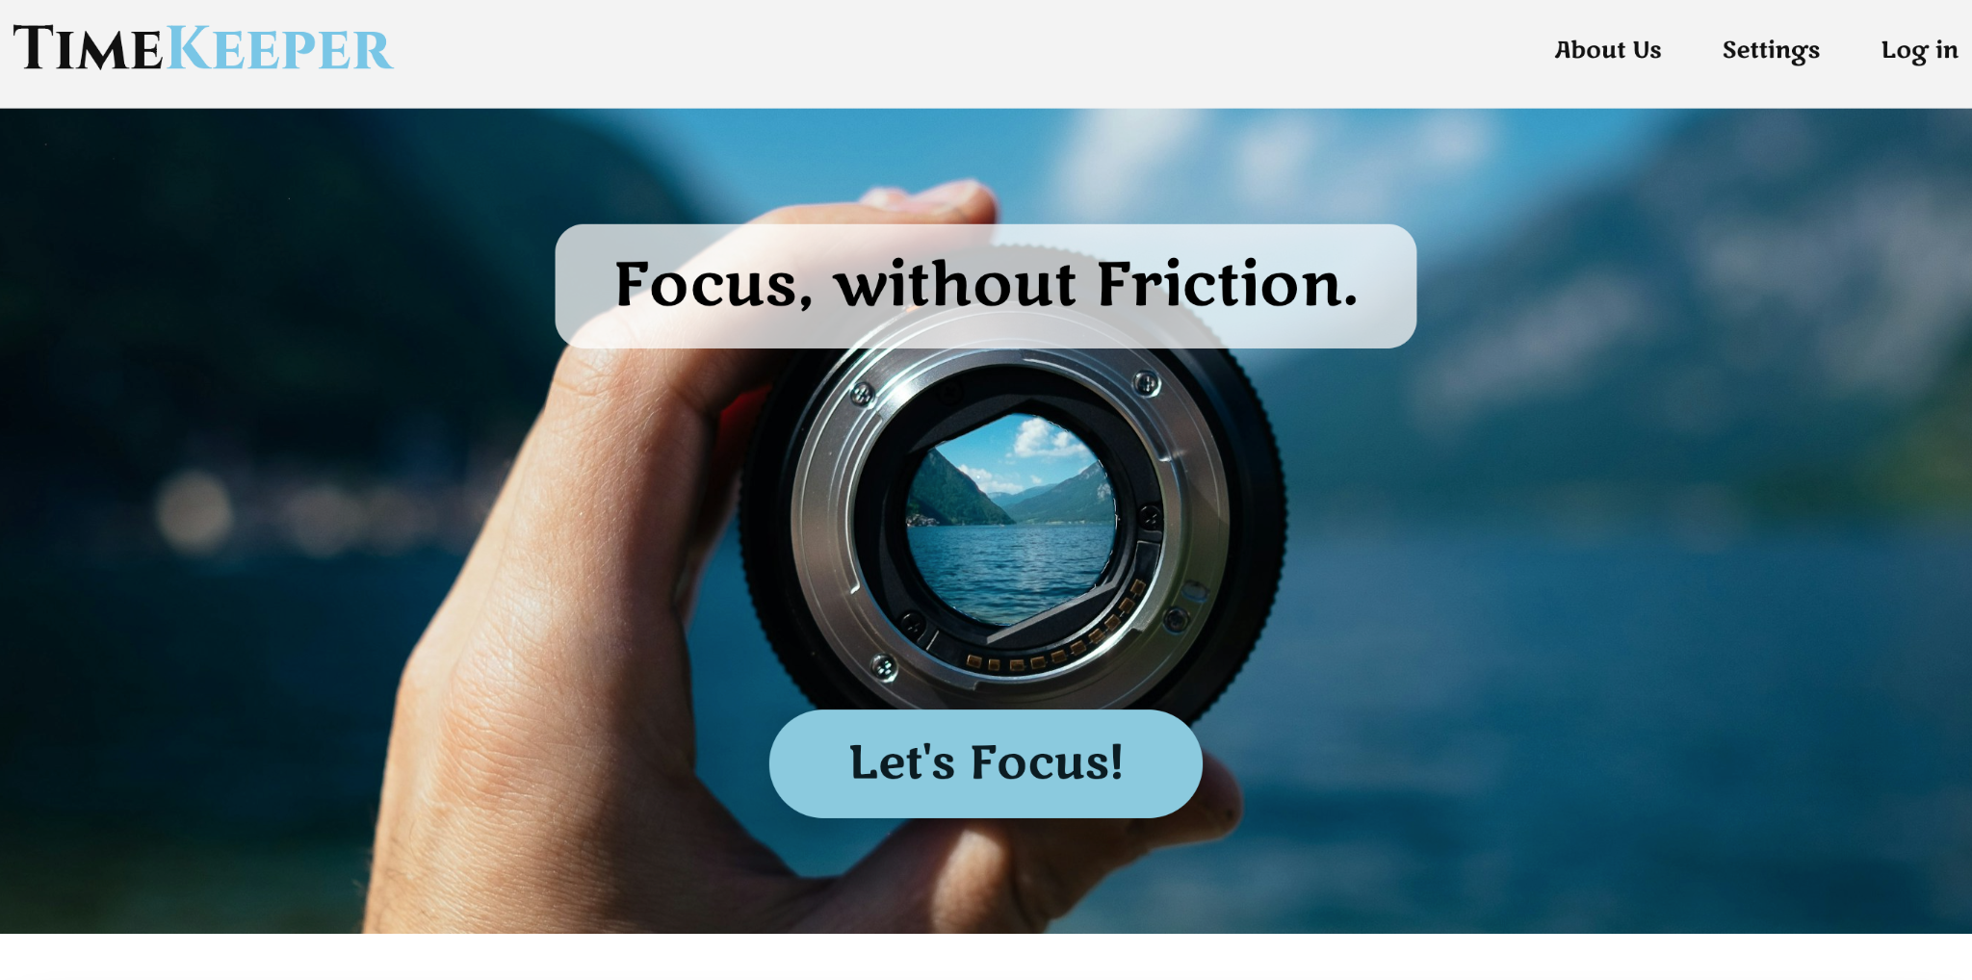
Home Page
✔ “Let’s Focus” button navigates to Timer page Result: ✅ Passed
✔ “Learn More”, Settings, Log In, Privacy, Terms, Social Media buttons are navigable Result: ❌ Failed (Buttons not clickable)
Test Type: Functional | Positive Testing
Overall Result: ⚠️ Partial Pass (1 Pass | 1 Fail)

Slide 12
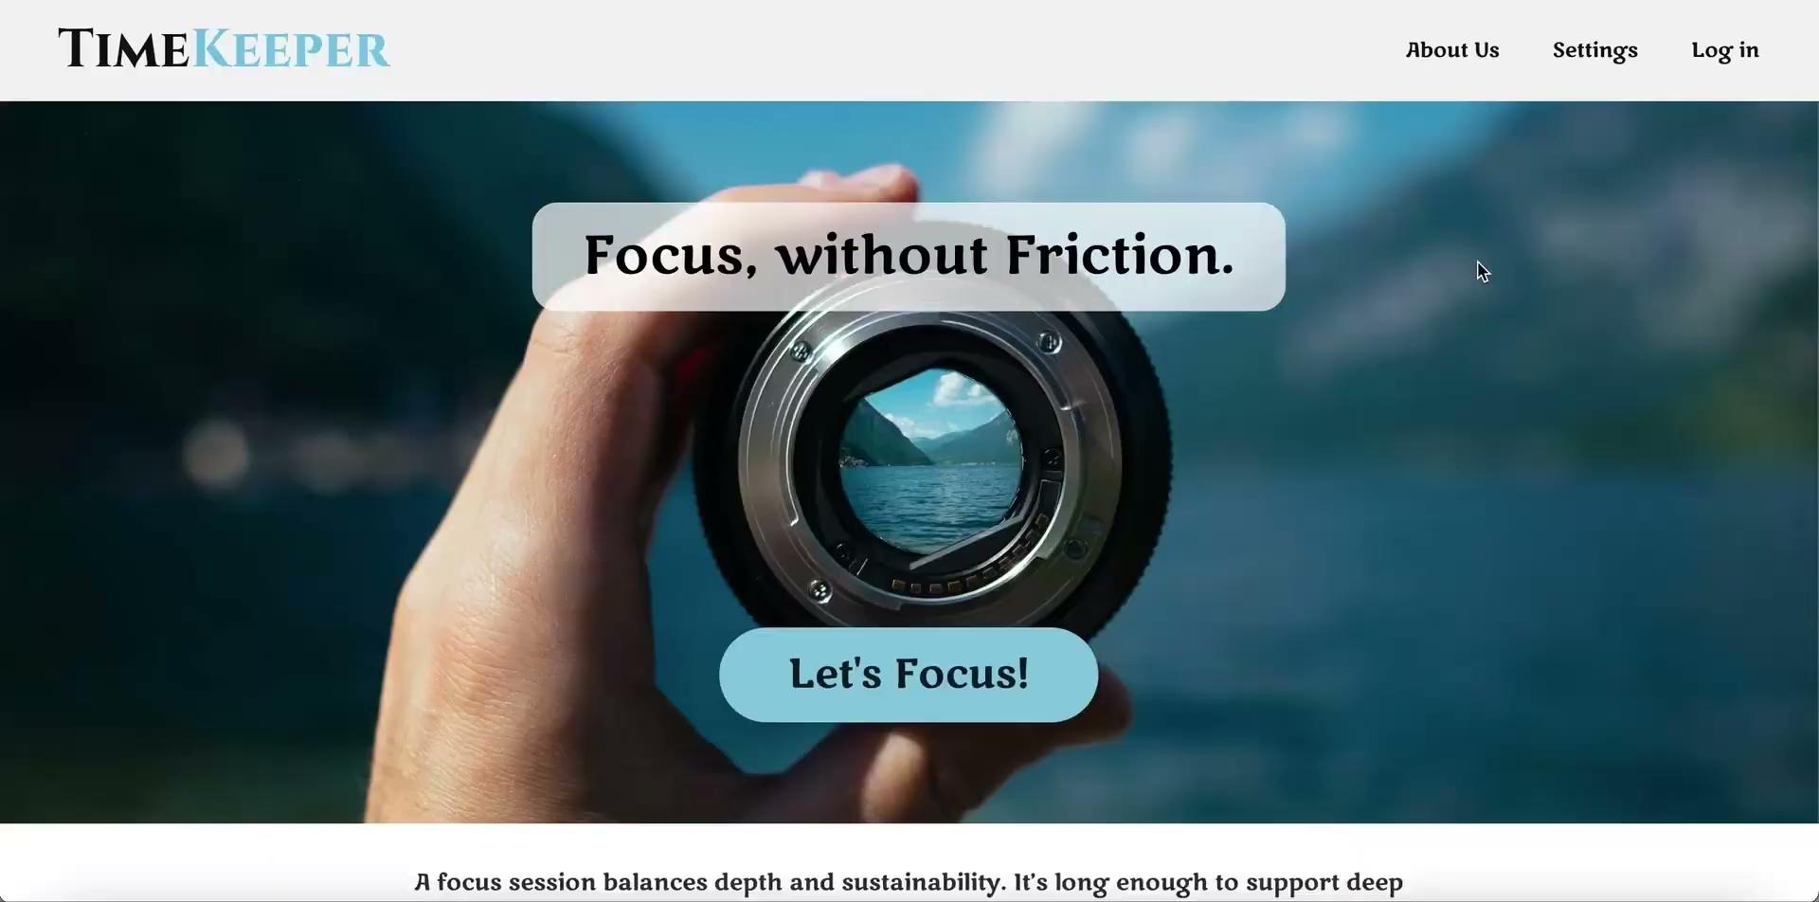
High Priority Bug
"Learn More" buttons and other navigation buttons (Settings, Log In, Privacy, Terms, Social Media) are not clickable on Home Page

Slide 13
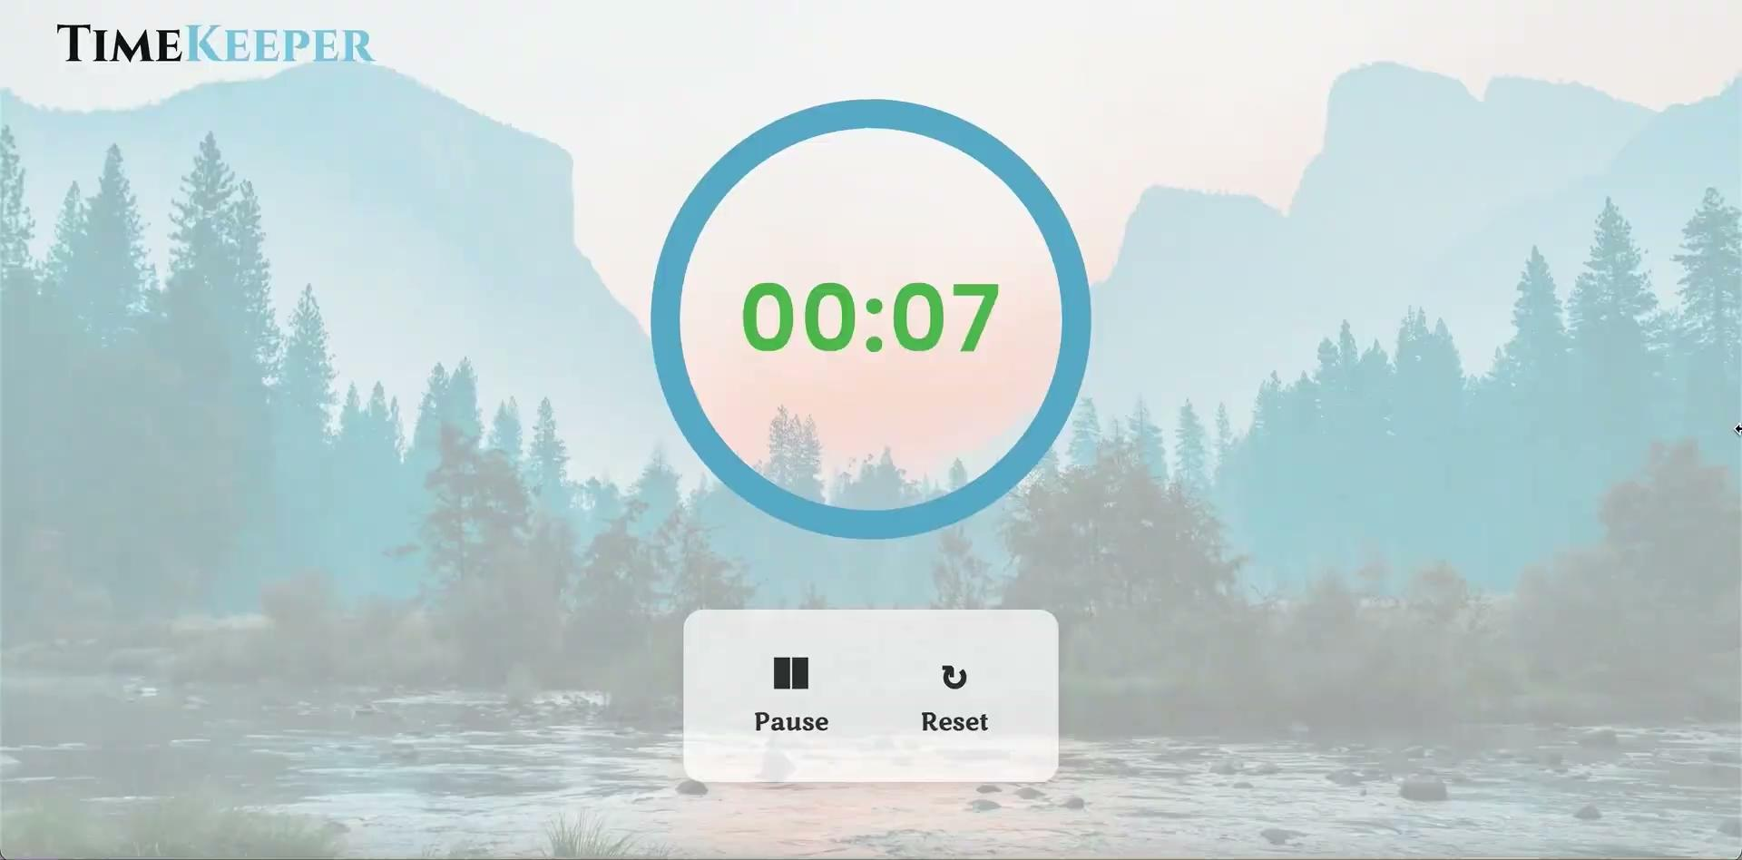
Great Job Screen
Trigger: Timer completes
✔ “Great Job” screen displays after timer finishes ✔ Total completed focus sessions shown ✔ Weekly total minutes (Sun–Sat) displayed ✔ Weekly count resets at 12 AM Sunday (EST) ✔ “New Session” returns user to Timer Selection page
Test Type: Functional | Positive Testing
Overall Status: ✅ All Test Cases Passed

Slide 14
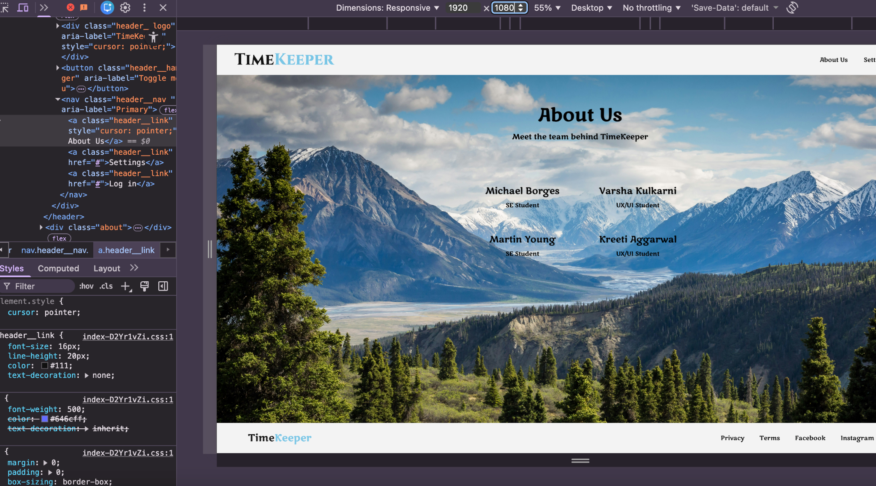
Performance
✔ Timers load and transition without delays → ✅ Passed ✔ Full keyboard navigation supported → ✅ Passed ✔ Proper titles, headings & navigation structure → ✅ Passed ✔ Chrome browser compatibility → ✅ Passed
❌ Missing alternative text (Accessibility) ❌ Layout breaks at 200% zoom ❌ Unclear language & lack of instructions ❌ Layout overlaps at 400×600 resolution ❌ Mobile layout cut off
Test Coverage: Performance | Accessibility | Usability | Responsive | Compatibility
Overall Result: ⚠️ 4 Passed | 5 Failed

Slide 15
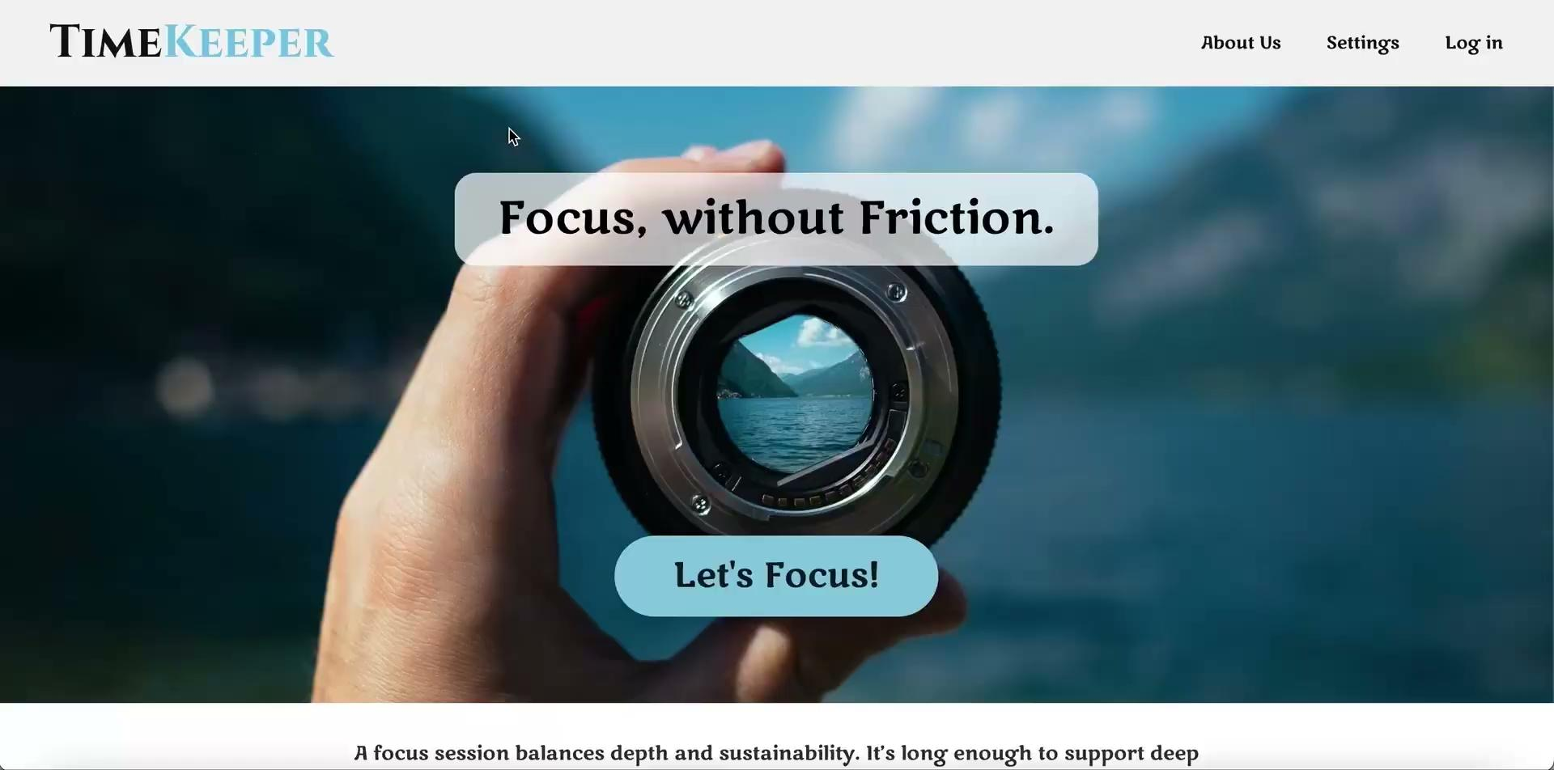
Medium Priority Bug
Unclear and Inaccessible Language in About Us and Timer Page

Slide 16
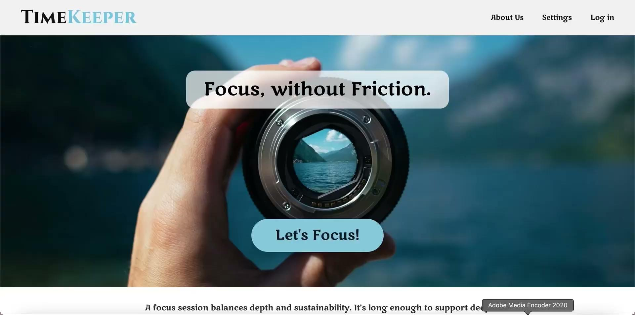
Low Priority Bug
Missing Alternative Text for Non-Text Content on Home Page, About Us page, and Great Job screen

Slide 17



Slide 18
Bug Jam – Automation Testing
Test Steps:
Open Timekeeper app
Click “Let’s Focus”
Select an inactive timer (ex: 15 minutes)
Verify selected timer becomes active
Tools:
Python
Selenium WebDriver
Pytest
ChromeDriver
Page Object Model (POM)
timekeeper_automation/
│
├── pages/
│ └── timer_selection_page.py
│
├── tests/
│ └── test_timer_selection.py
│
├── conftest.py
├── requirements.txt
└── README.md

Slide 19
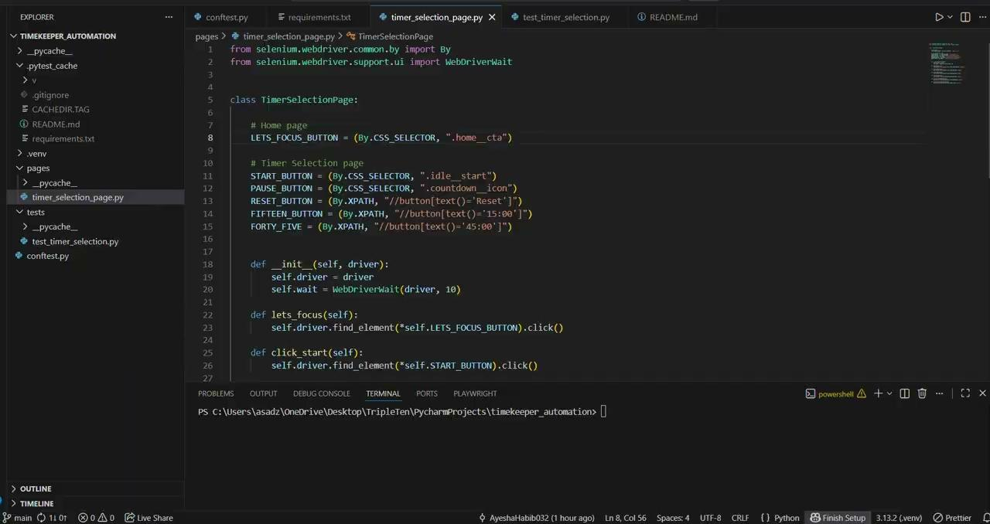

Slide 20
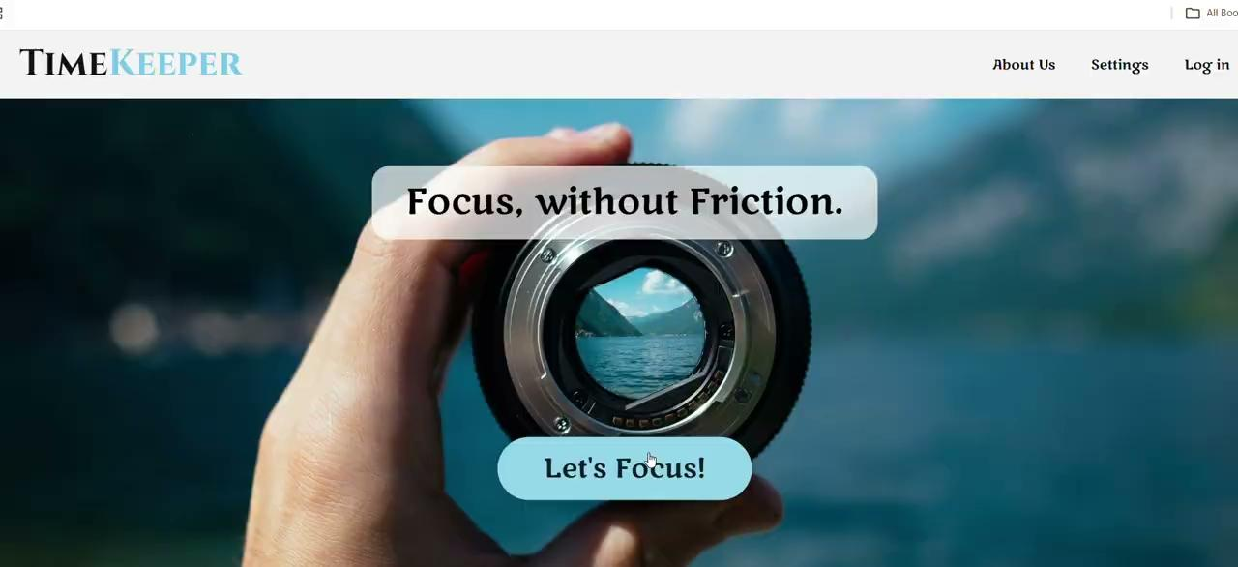
Compatibility Issue

Slide 21

Conclusion
All core user flows were successfully validated: Home → Timer Selection → Active Timer → Completion.
Functional testing confirmed correct timer selection, activation logic, countdown behavior, and navigation between screens.
Edge cases such as rapid clicking, multiple selections, and page refresh were tested and handled properly.
Non-functional testing verified acceptable performance, responsiveness, and basic accessibility checks.
Automation testing was implemented using Selenium & Pytest to ensure regression coverage and repeatable validation of critical flows.

Slide 22

Improvements & Future Enhancements – Timekeeper App
Fix homepage button clickability issues
Improve mobile responsiveness (resolve overlapping elements)
Add accessibility support (alt text, ARIA labels, keyboard navigation)
Expand automation coverage for cross-browser and edge cases

Slide 23
Thank You
Ayesha Habib
https://www.linkedin.com/in/ayesha-habib92/
https://github.com/AyeshaHabib032/timekeeper-selenium-automation/tree/main
Eduardo Villagomez
https://www.linkedin.com/in/eduardovillagomezg/
Rosa Miranda
https://www.linkedin.com/in/rosa-anice-miranda/

